Slide 1
CHAPTER 3: Introduction to Knowledge Studio

Slide 2
Contents
Introduction to Altair Data Analytics Products
Knowledge Studio Applications
Interface Components
Wizard driven design
Using Nodes
Filtering and Searching
Using the Workflow
Help Options

Slide 3
Introduction to Altair Data Analytics
Altair Data Analytics products include:
Monarch
Knowledge Hub
Panopticon
Knowledge Studio
SmartWorks
Each brand provides unique solutions for enterprise level applications for data acquisition, preparation, modelling, deployment, automation, distribution, streaming, governance, gamification and socialization of data

Slide 4





What is Knowledge Studio
A software tool
Advanced visual modeling and visual predictive analytics tool
Used for data exploration & the development and deployment of models
Successfully deployed in several Fortune 500 organizations
1,000+ registered users
100+ organizations
25+ countries
Notes:
with over 1,000 registered users from over 100 organizations in more than 25 countries
Examples of companies that are fortune 500 organizations: Royal Bank of Canada, Manulife, Duo Bank, TD, Scotia Bank, Toyota,

Slide 5
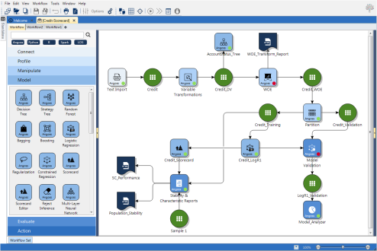
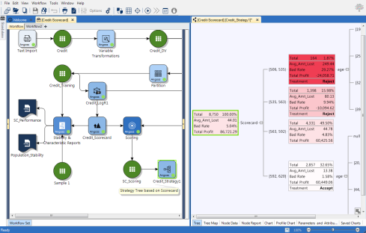
Knowledge Studio
Workflow Automation | Automated workflow creation and reusability, simple drag & drop steps
Data Preparation & Profiling | Join, append, aggregate & remove duplicates, import and connect multiple data sources. Univariate statistics, variable charts, cross-tabs, segmentation & correlation analysis; Chart Library to save & organize
Best-in-class Decision Trees | Robust Decision Tree functionality (CHAID, Entropy, Gini) Categorical or Continuous Target; Binary or Multiple Splits; Full split Control - Advanced control & features for power users
Strategy Trees | Predictive strategy design and deployment using a simple, intuitive decision tree framework – Patent Pending
Advanced Modeling | Advanced Models: Linear and Logistic Regression, Constrained , PLS and Regularized Regression, Neural Networks, Market Basket Analysis, Scorecards. Unsupervised Learning: Principal Component Analysis, Cluster Analysis, Survival Analysis, Model Selector
Model Analyzer | Model performance and sensitivity evaluation, comparative model evaluation with cumulative lift and many others
Real-Time Scoring | Intelligent, real-time scores/recommendations delivered to operational systems in real-time
In-Database Analytics | Connect directly to a parallelized and optimized enterprise data warehouse to perform data mining and predictive analytics directly on data stored in a database
Model Deployment | Direct deployment, real-time scoring and automatic generation of SAS, SQL, SPSS, PMML, and Java code
R & Python Language Integration | Users can write R and Python programs, embed them in workflows, develop models with R & Python data sets and generate/deploy enterprise ready SAS, SQL, and PMML Code

Slide 6
Knowledge Studio Applications
Credit Risks: banks, credit card companies
Screen and monitor their clients over the entire credit lifecycle
CRM and Marketing
Customer segmentation, cross and up-selling
Churn and retention, customer acquisition and targeting
Response models
Fraud and Money Laundering detection
Score transactions for the likelihood of fraud
Collections and Debt Recovery
Identify clients likely to pay back and estimate recoverable
Notes:
- Application (e.g. interest rate) and behaviour monitoring(what should I offer them- How do I want to treat these customers)
– Collection departments are using . Estimating the amount you can take back -In collections who should I contact in order to make them to pay back

Slide 7
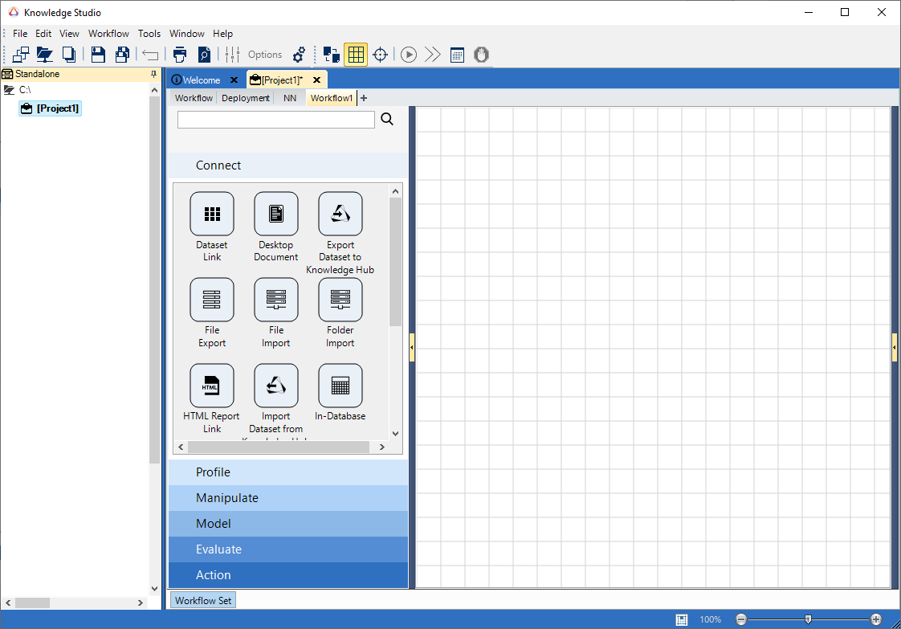
Interface Components
Main Menu
Task Bar
Working Directory
Workflow Canvas
Projects
Project Pane
Nodes
Palettes

Slide 8
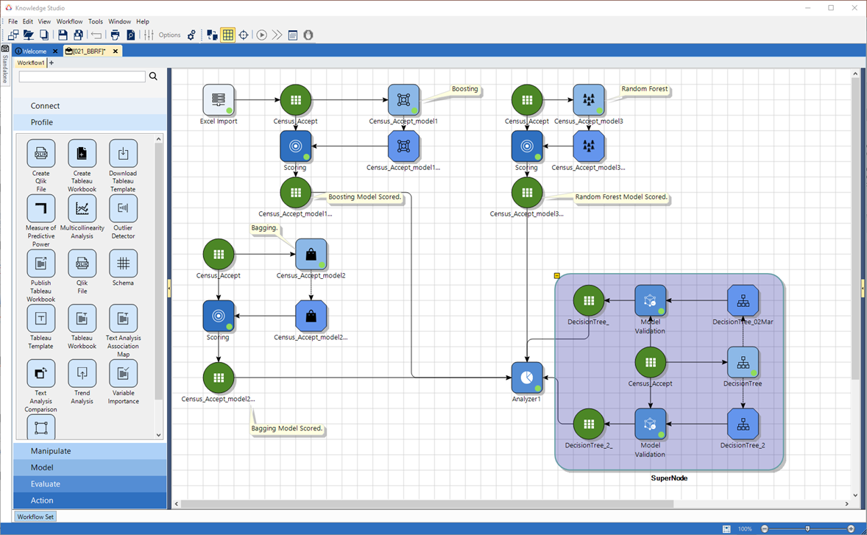
Wizard Driven Design
Everything in Knowledge Studio is driven by wizards to guide users
Workflows/processes are broken into discrete steps, which are organized visually by nodes
Opening a node will cause a wizard to pop-up
Once the wizard is filled in and the process is run, the node will represent a completed process step. In some cases, there will be an artifact here (e.g. a model) which the user can explore through the same node.

Slide 9
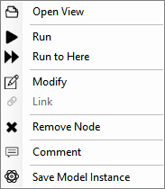
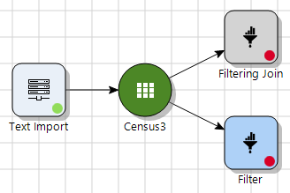
Using Nodes
Two ways to create new nodes:
Drag and drop nodes from palette to canvas, then connect by dragging arrows
Drag arrow from existing node, then select new node from dropdown
Node menu: right click
Options are context specific
Of particular note: Open View, Modify, Comment, Remove
Double-click will either open the wizard or open the node view depending on node state
Node states:
Greyed out: Inactive/missing connections
Red: Accessible but incomplete
Green: Run/Complete

Slide 10
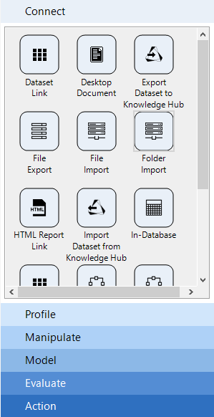
Palettes
Node Group | Description
Connect | Nodes for importing and exporting from/to a variety of data and model sources
Profile | Nodes for profiling data
Manipulate | Dataset and record level operations such as joining, appending, deduplicating, aggregation, new variable creation
Model | Modeling nodes
Evaluate | Nodes for assessing model’s performance
Action | Nodes for translating models to code. Documentation nodes, optimization, scheduling and coding nodes

Slide 11
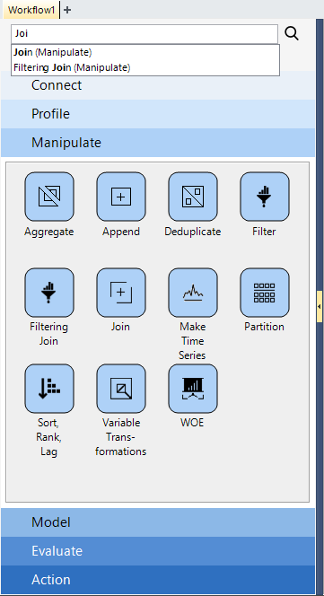
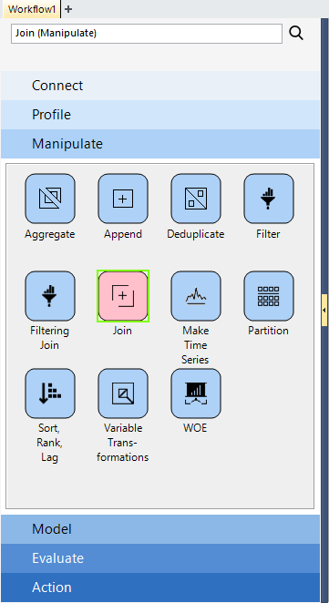
Filtering & Searching
Locate nodes using the search facility

Slide 12
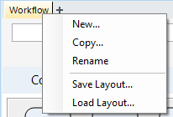
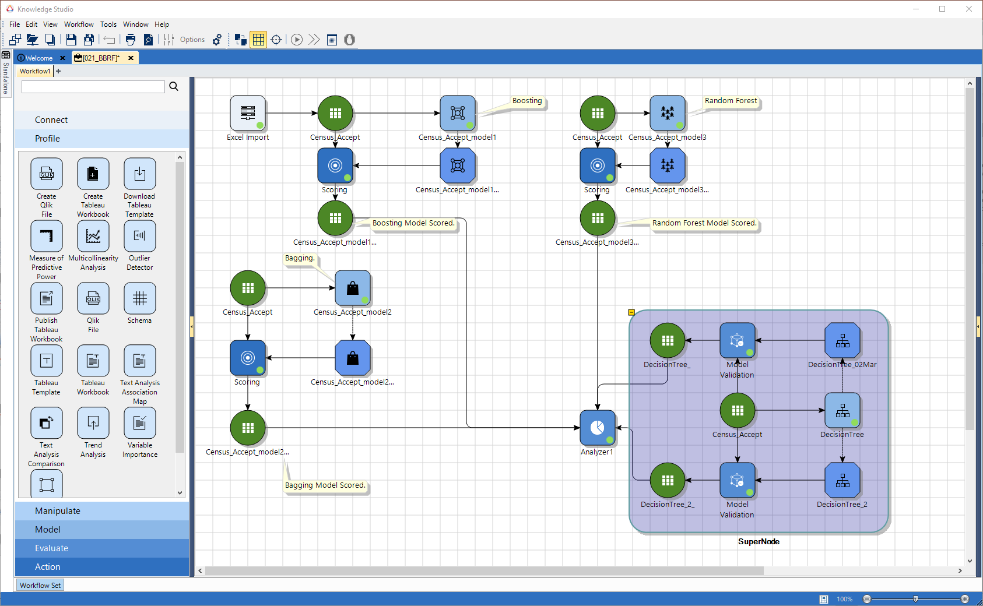
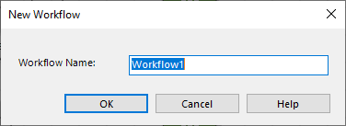

Complex of Multiple Workflows
Notes:
For visual organization and keep things simple and straight forward.

Slide 13
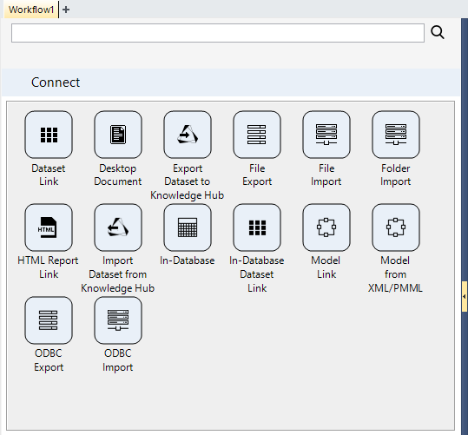
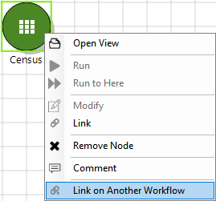
Linked Workflows
Link Data/Models across Workflows

Slide 14
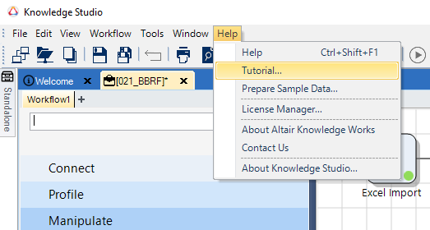
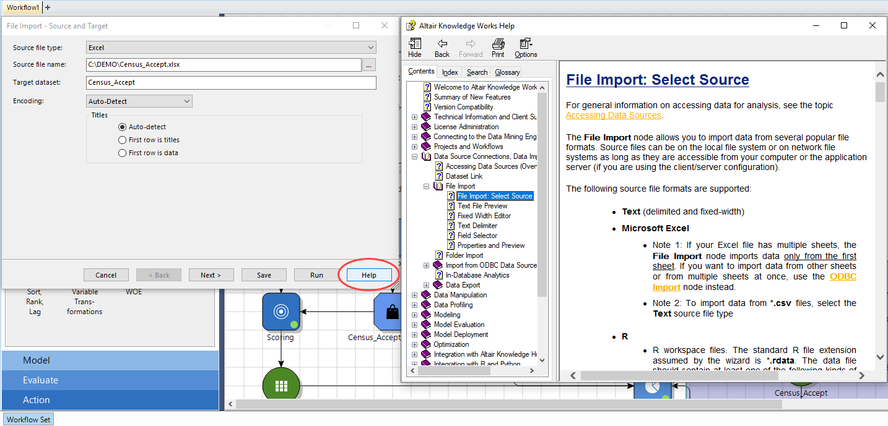
Help Options
Help menu
Demos
Tutorials

Slide 15
Chapter 3 Exercises
Start Knowledge Studio
Using the File menu
Set an appropriate Working Directory to store projects. This can be any location of your choosing
Create a new Project and give it a name of your choosing
Explore the different node palettes and become familiar with the nodes contained therein
Open the Help files and locate information on the topics:
Working with projects
Importing Data (Overview)
NOTE: These can be found from the Contents tab
Access Context Sensitive Help for the Import Node

